Slide 1

Board of Directors Meeting
Baker, Manock & Jensen
December 5th, 2018

Slide 2
Call to Order

Slide 3
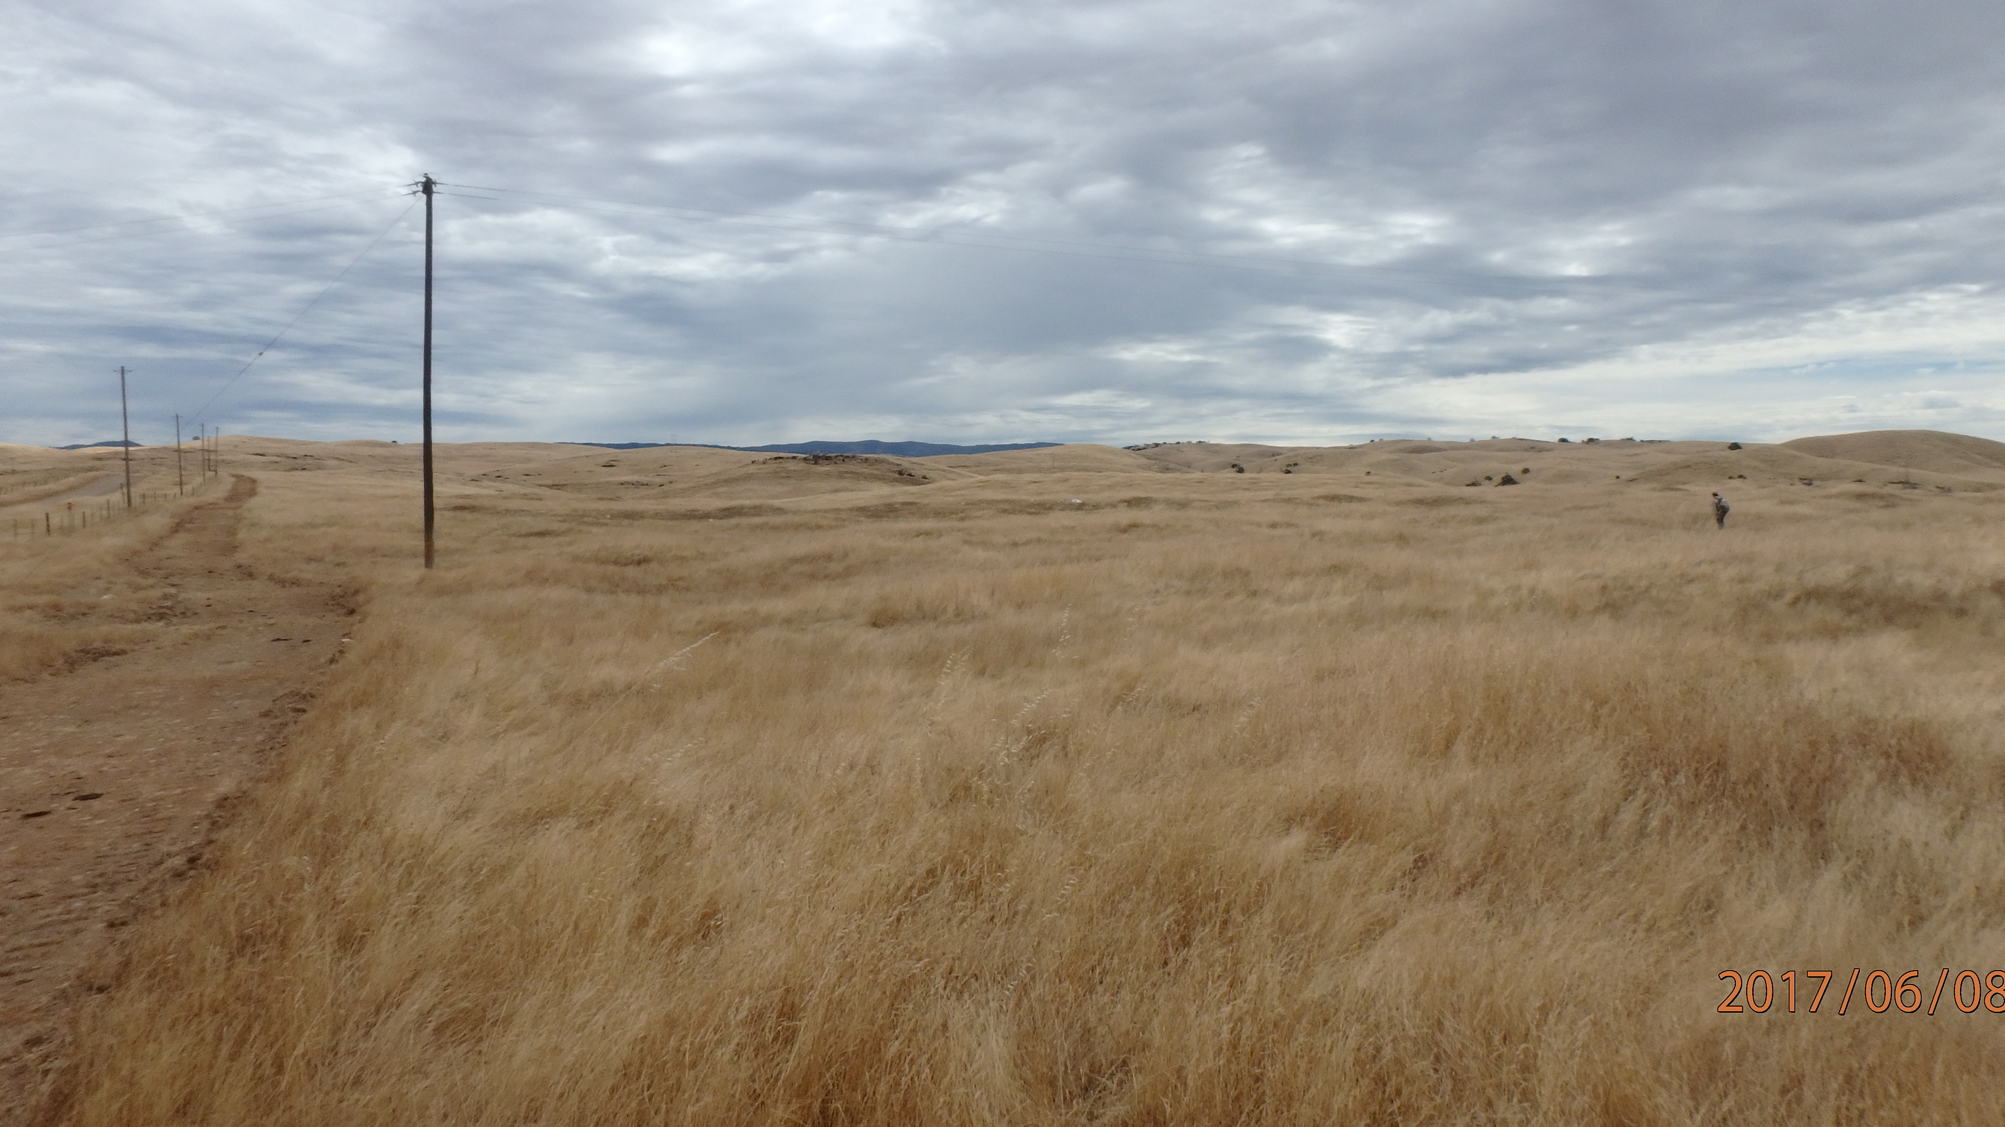

Consent Agenda:
Minutes from October 20, 2018 Meeting

Slide 4

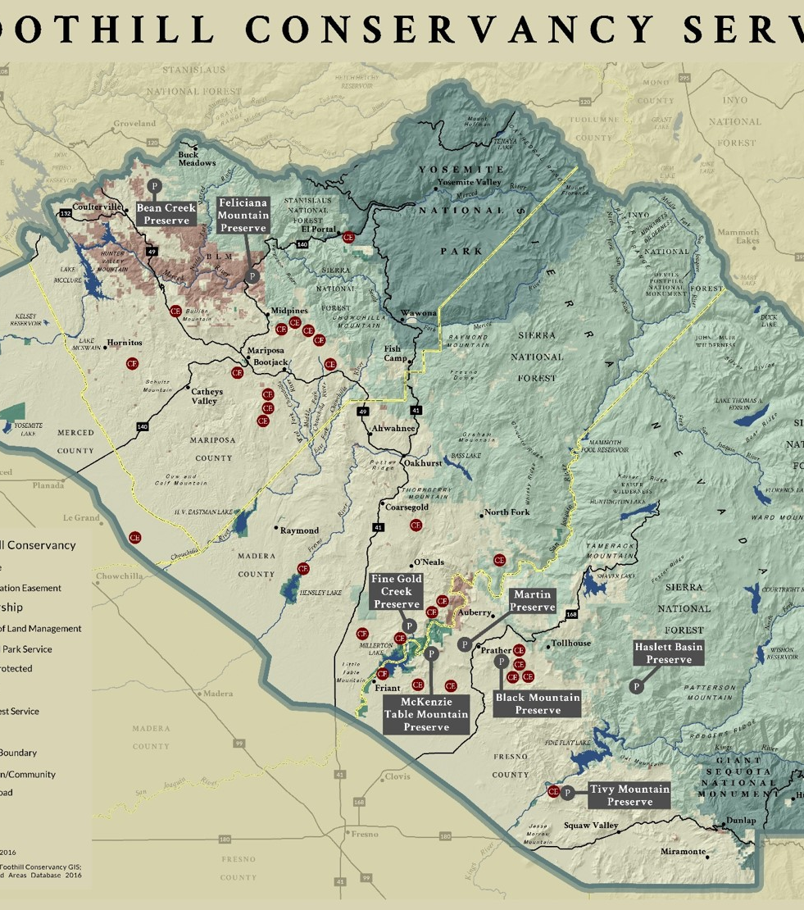

Agenda
z
z
5:00 PM Social Time: Please join us for social time with food provided by SFC staff
5:30 PM Call to Order
5:30 PM Consent Agenda:
  Minutes from October 20,2018 Meeting
5:35 PM Governance
5:40 PM Announcements/Information
5:45 PM Treasure’s Report (1st Qtr 18-19 FY)
5:50 PM Development Report (McKenzie Campaign Update)
6:00 PM Discussion/ Requests for Approval
7:00 PM Logistics for next meeting (January 23,2019)
Adjourn to Executive Session

Slide 5
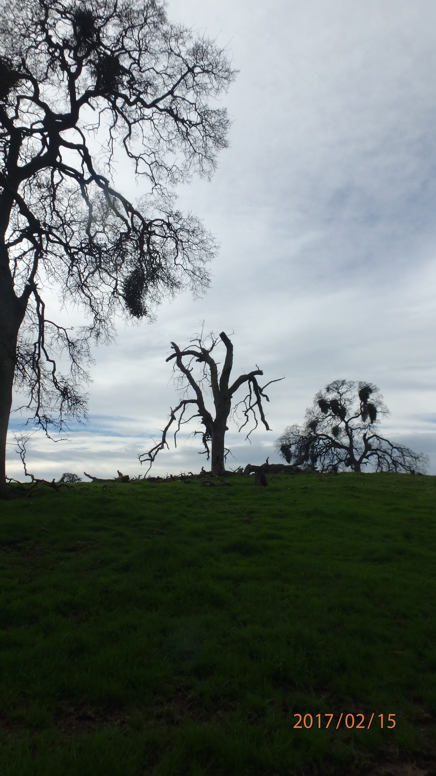
Governance
z
z
Vote To Approve Paul Beare as Board Member
Vote on 2019 Slate of Officers

Slide 6
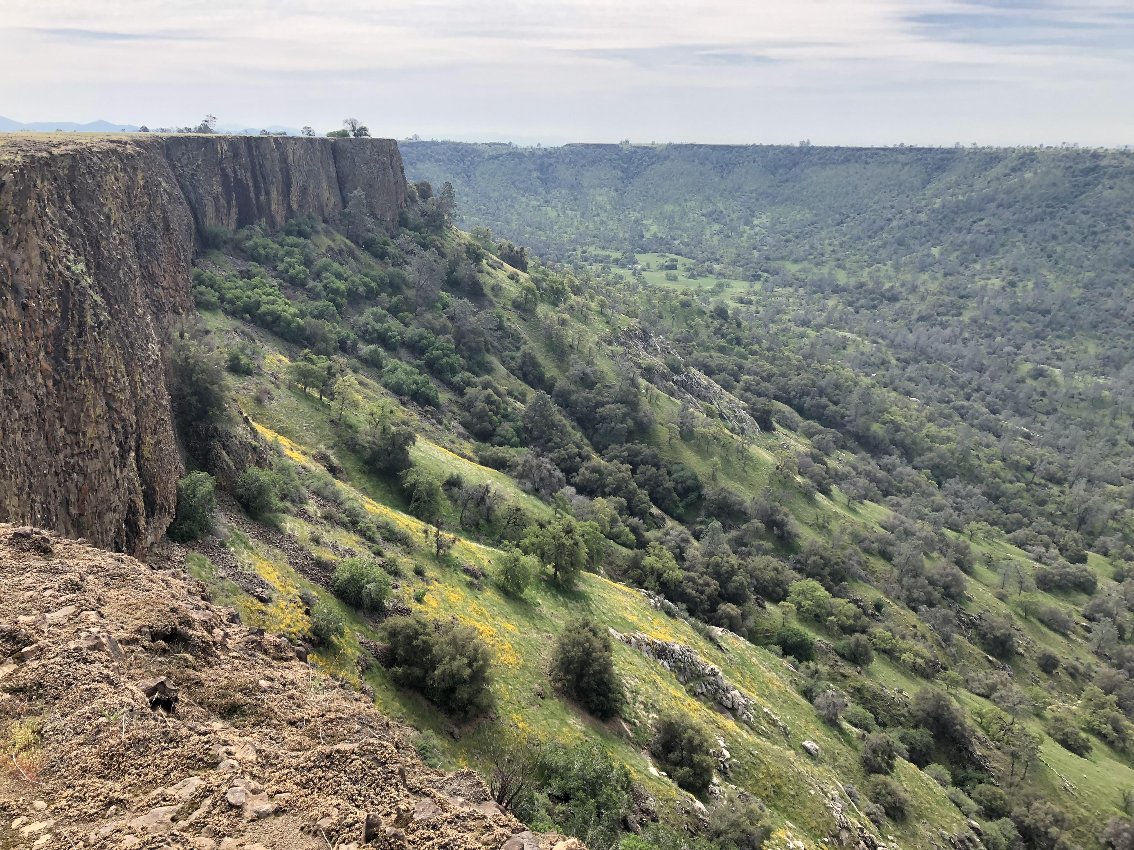
Announcements /
Information

Slide 7

z
z
Executive Directors and Staff Reports

Slide 8
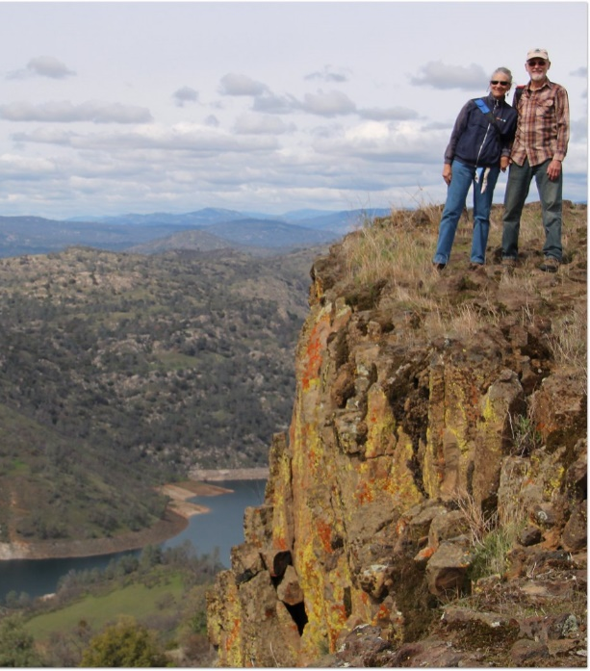
Sierra Foothill Conservancy 2018 Highlights

Slide 9
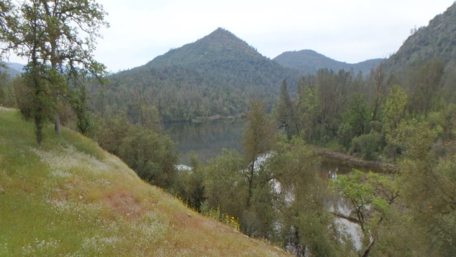
Over 32,000 Acres Preserved!
Increasing the Pace of Conservation and celebrating over 32,000 acres preserved with the closing of 3 projects in 2018:
Willow Creek CE
Kerckhoff Reservoir CE
And
North Shore Off-Site Mitigtation CE

Slide 10
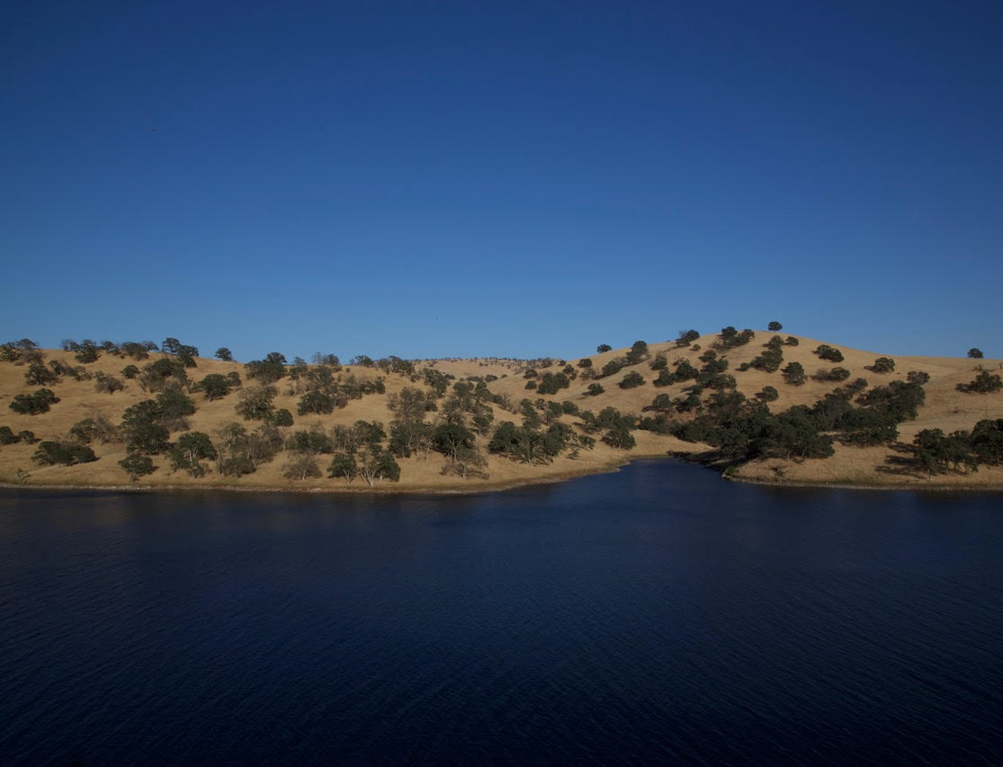

Projected to Conserve over 40,000 acres by end of 2019!
On the path to conserve more land than in any time in SFC history:
8,000 acres in Grant Funded Projects
1,600 acres in Stewardship Council Projects
1,100 acres in Mitigated CE’s

Slide 11
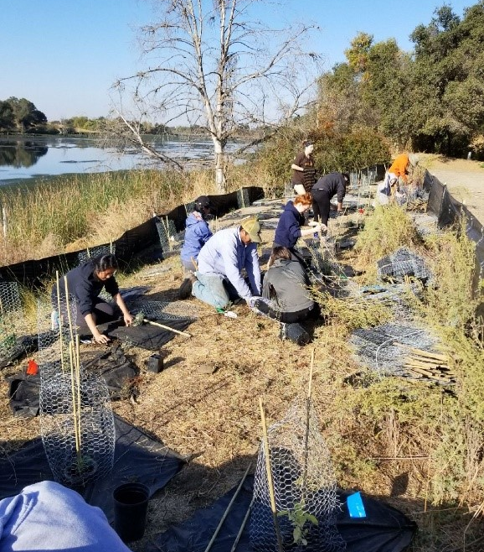
Merced Falls Restoration Project
Implementation of the Merced Falls Restoration Project:
Planning, design and implementation collaborations with SFC staff, the Central Valley Conservation Corps, and Nature Force high school students, we installed 280 plants which included weed cloth, browsing protection, gopher baskets and irrigation.

Slide 12
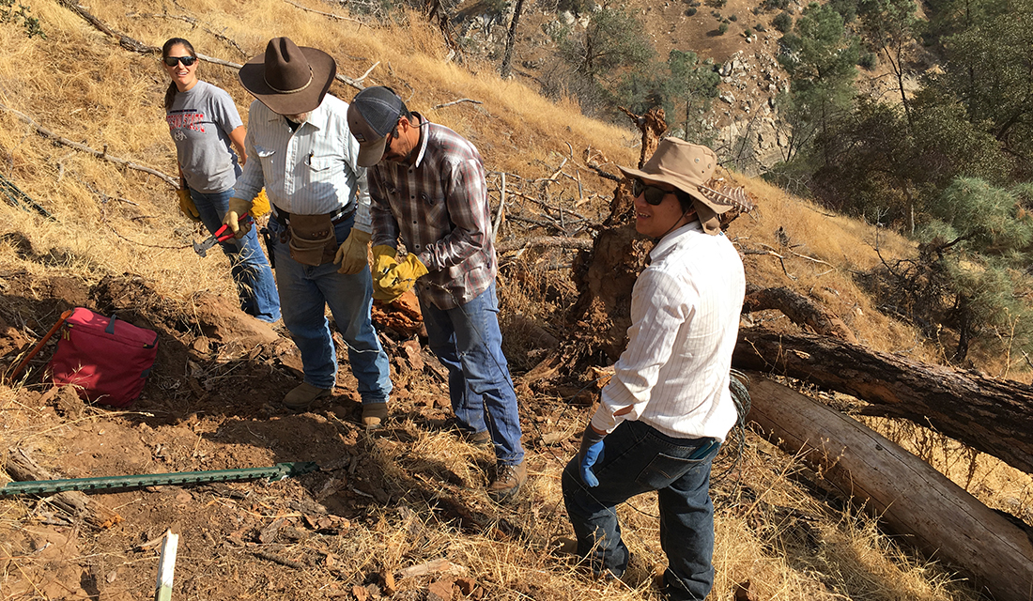
Our 2018 Interns
Interns Interns Interns!
SFC was awarded grant funding for 2 FT summer interns through CCLT who worked with Stewardship Staff on various projects from invasive species removal to fencing projects.
This fall, in collaboration with Fresno State we worked with U Moa on a fall internship where he planned and led trail work days and hikes.

Slide 13
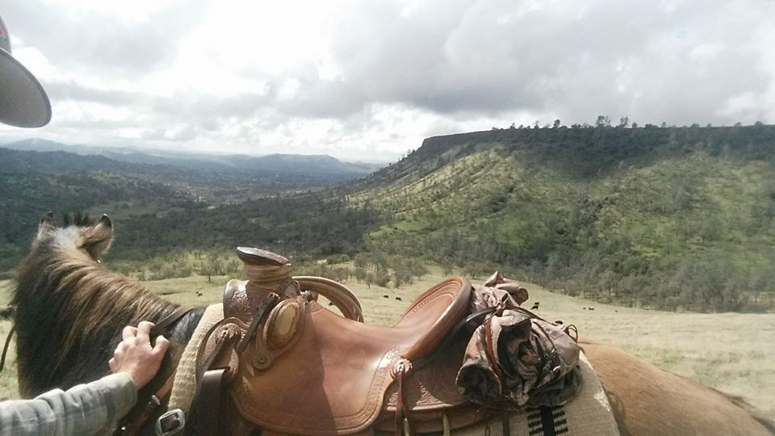
Out on the Range
Titan, the new horse for the Rangeland Program has been a delight for everyone who meets him but a significant resource for Billy.

Slide 14
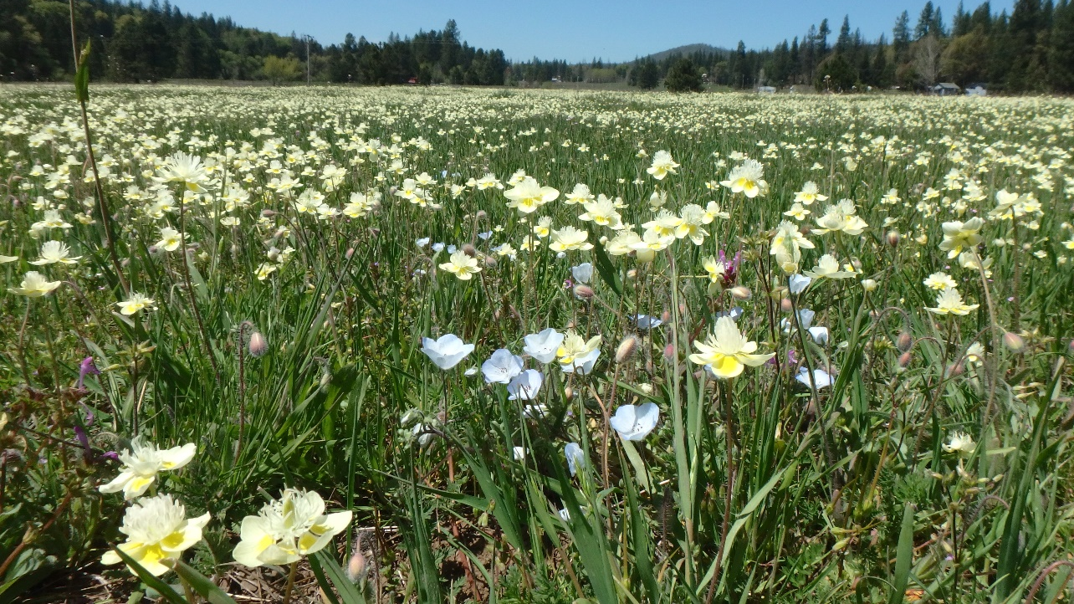
Expanded Fundraising & Membership Development
Highest active membership with significant strides in gaining NEW members and increased % of renewals brings SFC to over 2,100 members!
Executive Directors Circle Formed with 20 guests at our first Executive Directors Circle Dinner.

Slide 15

Trelio Ranchers Pairing
Trelio Ranchers Pairing
20 Guests were delighted by a 4 course meal using our very own SLB Beef and paried with delicious wines.
Promoting and highlighting our holistic grazing program and the organic grass-fed beef along with wonderful food and company!
This fundraiser earned over $2,000 for the organization!

Slide 16
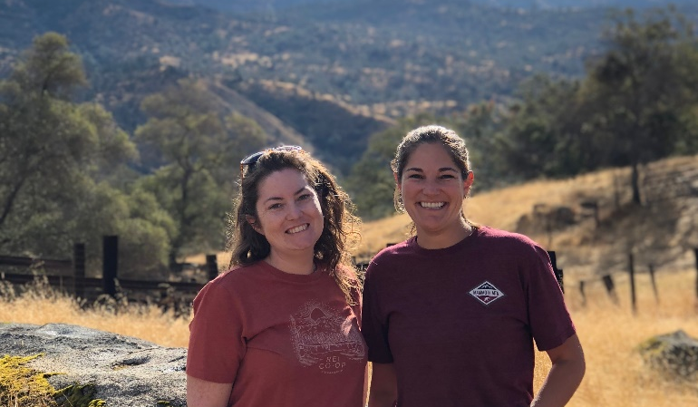
Education & Outreach
With expanded Hikes & Classes we have increased accessibility to our Preserves by over 20%
Additional staffing resources with two new hires:
Allyson Brooks, Education & Stewardship Coordinator
Lindsey Roberts, Outreach Manager
Fresh energy and ideas – it’s an exciting time!

Slide 17
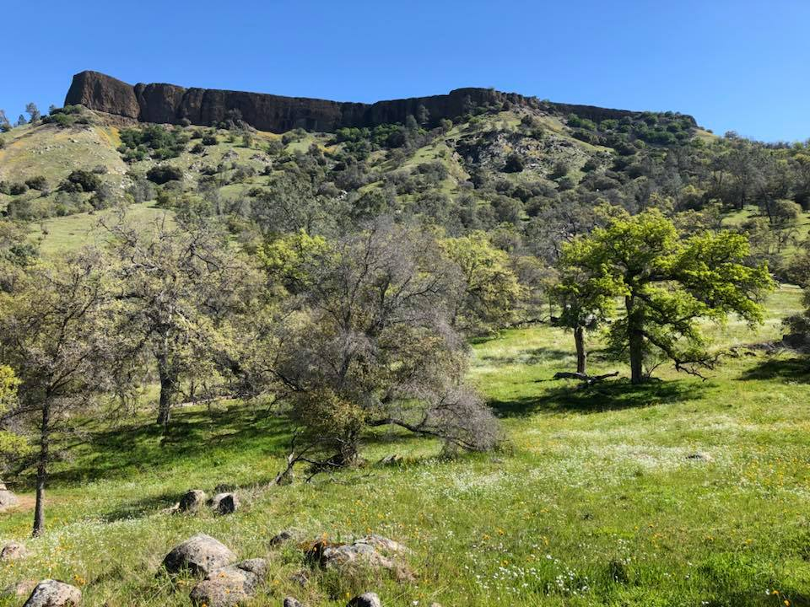
Media & Communications
We worked with UC Merced for a classroom documentary highlighting the McKenzie Preserve and effective partnerships in conservation featuring Rangeland Manager Billy Freeman.
Bridget, interviewed by Sierra Nevada Conservancy, represented the Sierra region and spoke about the need for funding collaborations for effective preservation.
Bridget now has a monthly article in the Mariposa Gazette that highlights current topics relevant to the region and the Organization. For 2019 we are developing a similar structure with the Prather based Mtn Press.

Slide 18
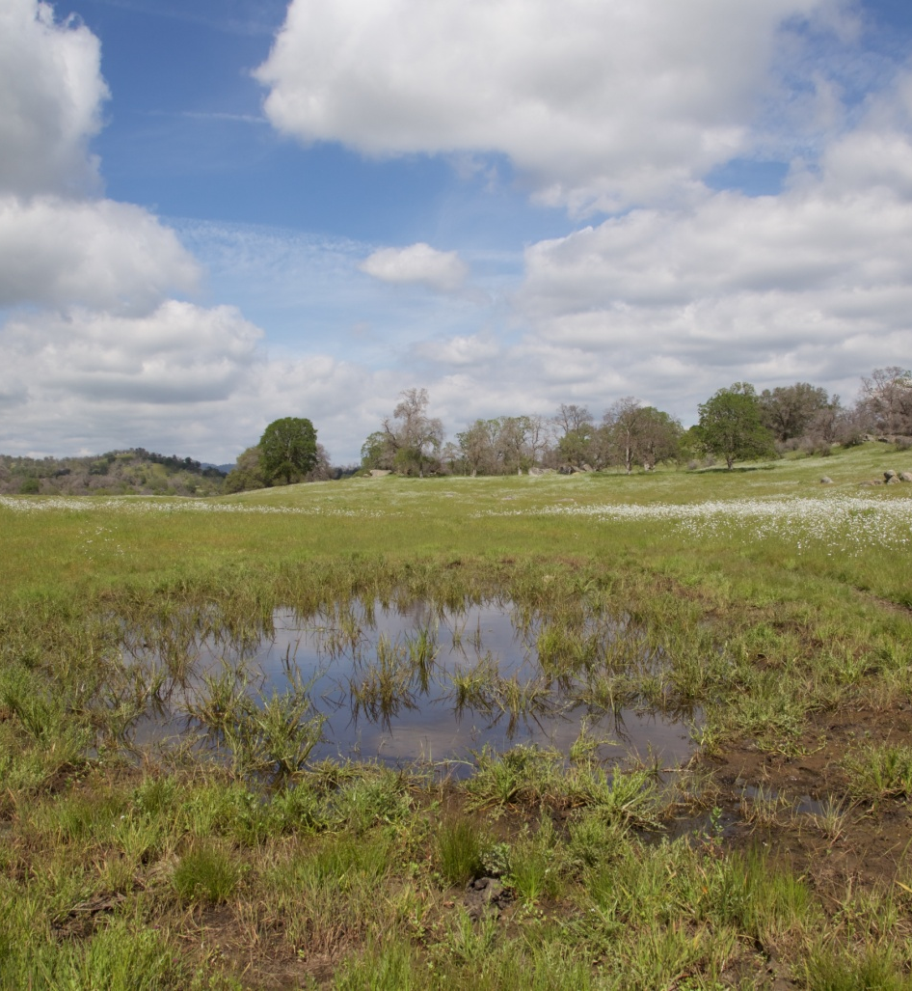
Grant Awards
Grant Awards:
Land Trust Alliance Excellence Grant awarded for $7,000.
REI Outreach Grant: $7,000
Stockton Creek Preserve Enhancement Grants: $240,000
Hornitos Ranch: $5,405,000
McKinney Grant Total: $3,669,370
$11.6 million in total funding for Acquisitions!!

Slide 19
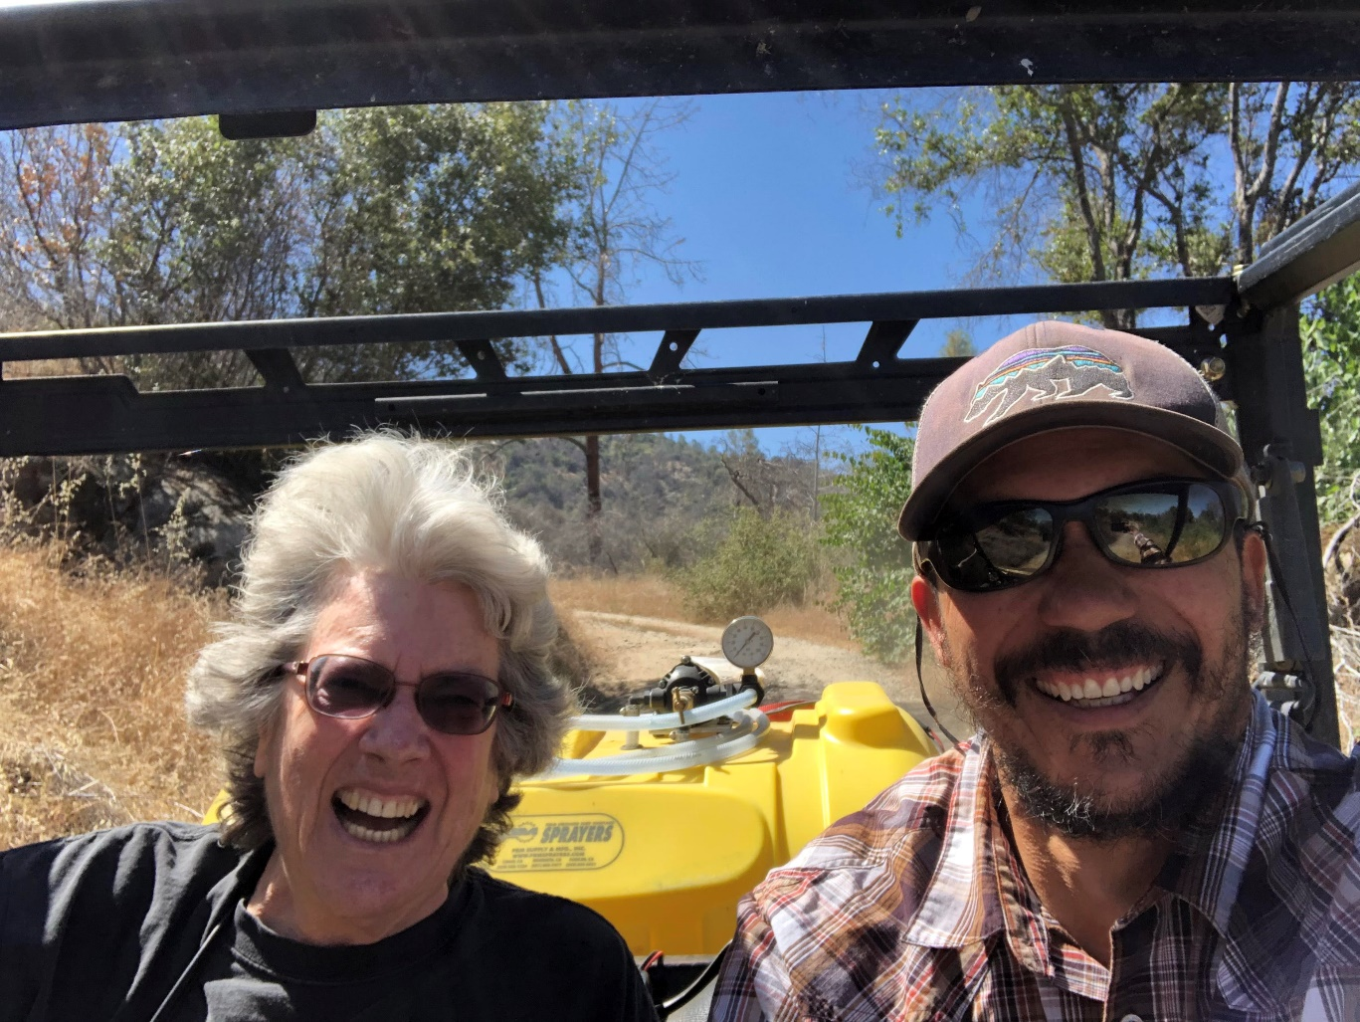
Management Accomplishments
Hosted staff & board retreats
A successful unqualified audit for the third year in a row!
IT resources with new laptops for all staff and upgraded software.
Purchased 2 stewardship vehicles for increased efficiency and safety.
Increased investment in our Employees with 100% healthcare coverage and competitive salaries.

Slide 20
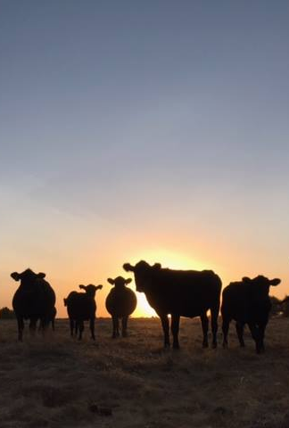
Public Policy Updates and Information
Prop 68 Implementation
Prop 3
On the Horizon

Slide 21
Treasurer’s Report
Budget Narrative for FY 18-19 1st Quarter
July 1, 2018 through September 30, 2018
SFC Fiscal Year End 2017-2018 Audit is almost complete, with auditors making their final reports. We plan to have Price Paige present at the January 23, 2019 Board Meeting.
The P&L for the quarter has outperformed against the FYTD budget. Due to timing of grant reimbursements for stewardship projects, December and January are expected to be lean months for cash flow. However, actual expenses in the quarter were significantly better than budget as some of the delayed project’s expenses were deferred and leadership adjusted and managed expenses to come in under budget. To improve cash flow during this time, we continue to analyze finances to lower expenses and optimize income and focus attention on project billing and follow-up calls on accounts receivables.
Cash Flow projection does remain strong and SFC will end the Fiscal Year 2018-2019 with a positive Net Income.

Slide 22
Balance Sheet
Provided is a comparative report to prior fiscal year showing the Balance Sheet (compressed version) as of September 30, 2018. SFC shows improvement with increased Cash & Cash Equivalents and a reduced Accounts Receivable total. NOTE: We are still waiting on various adjusting journal entries from Price Paige that may affect certain Balance Sheet Accounts – the 2nd quarter end review will show those adjustments.
 | 9/30/18 | 9/30/17 | $ Change | % Change
ASSETS
Cash & Cash Equivalents | 9,655,243 | 9,233,933 | 421,311 | 5%
Accounts Receivable | 68,908 | 129,301 | (60,393) | (47%)
Prepaid & Other Assets | 11,934 | 8,909 | 2,484 | 28%
Fixed Assets | 7,935,612 | 7,809,955 | 125,657 | 2%
Other Assets (Loans) | 151,692 | 183,506 | (31,814) | (17%)
TOTAL ASSETS | 17,822,849 | 17,365,603 | 457,246 | 3%
LIABILITIES
Accounts Payable | 78,508 | 42,061 | 36,447 | 87%
Credit Cards | 1,224 | 14,972 | (13,748) | (92%)
Payroll Liabilities | 45,561 | 35,789 | 9,772 | 27.3%
Accrued Liabilities | 125,951 | 218,873 | (83,150) | (33%)
EQUITY
Unrestricted Net Assets | 750,248 | 908,992 | (158,744) | (17%)
Temporarily Restricted | 4,026,282 | 3,143,544 | 882,738 | 28%
Permanently Restricted | 12,126,465 | 12,126,465 | 0 | 0%
Net Income | 154,912 | 327,659 | (172,747) | (53%)
TOTAL LIABILITIES & EQUITY | 17,822,849 | 17,365,603 | 457,246 | 3%

Slide 23
Cash Flow
.
November 2018 | December 2018 | January 2018 | February 2018 | March 2018 | April 2018 | May 2018 | June 2018
$11,500 | $35,000 | $298,000 | $286,000 | $504,000 | $652,000 | $671,700 | $640,200
PROFIT AND LOSS FINANCE DASHBOARD
Below is a snapshot of our current 1st quarter 18-19 Profit and Loss. Shifts in projected land acquisition closings will shift both income and expense to closer to budget as we move through the fiscal year.
INCOME | YTD Actual | YTD Budget | Over/Under
Program Grants | 22,911 | 38,309 | (15,398)
Temp Restricted Contributions | 1,070 | 2,768 | (1,698)
Unrestricted Contributions | 26,450 | 72,051 | (45,601)
Earned Revenue (FFS, Rent) | 75,069 | 108,455 | (33,385) | Below Budget
TOTAL INCOME | 125,599 | 221,583 | (95,984) | (57%)
EXPENSES | YTD Actual | YTD Budget | Over/Under
Personnel | 187,483 | 237,601 | (50,118)
Consultants/Contractors | 96,027 | 126,597 | (30,569)
Equipment | 2,163 | 18,610 | (16,997)
Material and Supplies | 8,049 | 42,712 | (34,663)
Program Support | 43,098 | 109,161 | (66,063) | Below Budget
TOTAL EXPENSES | 336,821 | 534,681 | (197,608) | (63%)

Slide 24
Fund Balances
The Fund Balances sheet reflects the September 30, 2018 balances of each of our Restricted Funds. The numbers in (parenthesis) are the protected principle of each fund.
As of September 30, 2018 there was Investment Dividend & Interest of $32,503, with Investment Gain of $259,433. This gives a combined Investment Gain of $293,873 which is a 6% increase over last FY. The Investment Committee met in September 2018 and reviewed that Funds are allocated in our portfolio per our Investment Policy, Proposed revisions to our Investment Policy which will be reviewed at the January 2019 Board Meeting along with an Investment Committee update and report. We project that during the remainder of the Fiscal Year an additional $5 million will be invested from the potential closing of over 6 Land Acquisition Projects before June 2019.
Investments
INVESTMENTS | YTD Actual | Prior FY YTD
Lodge Road Property Sale Loan Interest | 217 | 490
SLB Loan Interest | 1,938 | 2,169
Investment Dividends | 32,503 | 55,782
Gains in Invested Funds | 293,873 | 259,433
Land Acquisition Additions | 0 | 335,000
Endowment Contributions | 0 | 0
Temp Restricted Contributions | 72,000 | 234,680
Deferred Revenue Contributions | 0 | 0

Slide 25

Development
z
z
McKenzie 20th Anniversary Campaign Update

Slide 26
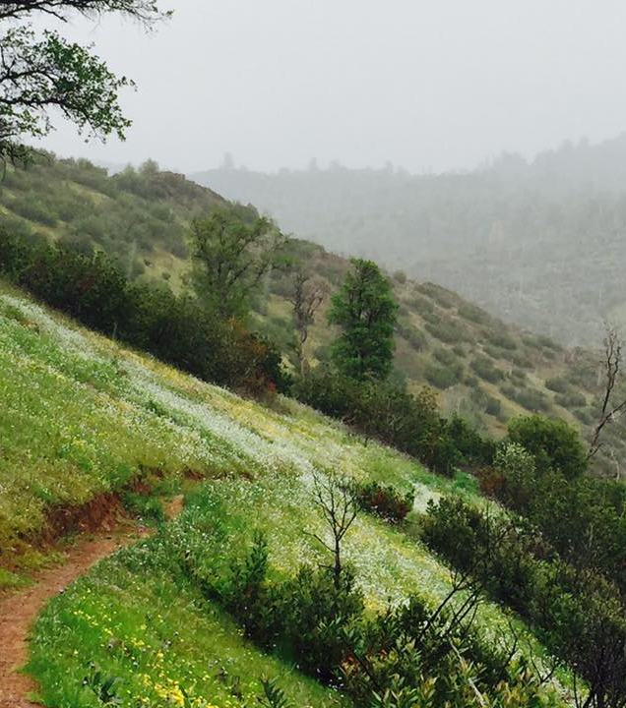
Discussion/
Requests for Approval
Resolution to Approve the Application for LTA Accreditation Renewal
Resolution to Approve Signature Authority for Vanguard Suite of Accounts
Policy Revision Materials
  General Summary:
  All active policies were reviewed against the newly released 2018 LTA Standards and Practices as well as the 2017 LTA Accreditation Handbook for Compliance with not only their stringent standards but also current local, state, and federal laws.
  Taken into consideration is current SFC Best Practices.
  Presented to the Board of Directors for review and approval are policies that were deemed necessary by executive leadership to comply with current standards and practices.

Slide 27

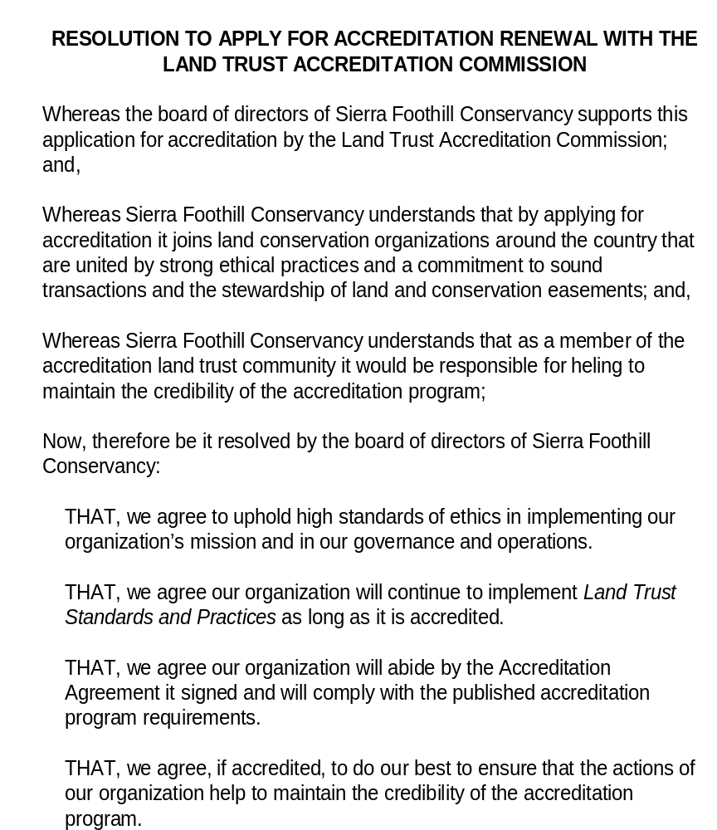
PASSED AND ADOPTED, by the following email vote on December 5, 2018
Yes
No
Abstain
Absent
Margot Cegielski, Secretary of the Board

Slide 28

RESOLUTION TO AUTHORIZE THE FOLLOWING INDIVIDUALS TO ACCESS THE VANGUARD SUITE OF ACCOUNTS
December 5, 2018
With regards to the Vanguard held investment accounts of Sierra Foothill Conservancy, specifically the Simple IRA, the Vanguard Federal Money Market Account, and the Vanguard Long-Term Investment Account, the following individuals are authorized by the Sierra Foothill Conservancy Board of Directors to have signature authority, to view and access information and reports and to authorize transfers based on our Investment Policy (Revised December 2018).
The following officers of the corporation have Signature Authority, and authorization for deposits and withdrawals:
  Paul Beare, President
  Lynn Gorman, Board of Directors
  Jon Edwards, Treasurer
The following directors of the corporation are authorized to view, access and facilitate all transfers, either deposits or withdrawals:
  Bridget Fithian, Executive Director
  Mary Kate McKenna, Operations Director
PASSED AND ADOPTED, by the following email vote on December 5, 2018
YES
NO
ABSTAIN
ABSENT
Attested to by
        Margot Cegielski, Secretary of the Board

Slide 29
Review of Policies with Edits for Review
Bylaws | Revised to Reflect Current Practices
Building Funds for Conservation Easement Stewardship and Defense | Extensive Edits to add language regarding Legal Defense Calculator (New LTA 2018 Requirement)
Records Policy | Reviewed, minor edits to current practices/ updated technology
Stewardship Procedures & Fund Policy | Reviewed, Revisions to update to current practice and Revised LTA Standards
Revised in three sections:
Article II: Offices, Section 2.01 – Principal Office
Propose to change language to have principal office within the service region and any changes would be at the discretion of the Board of Directors.
Article IV: Directors, Section 4.07 – Annual Meeting of Directors
Current Bylaws state annual meeting is to be held during a designated Saturday during the third quarter of each fiscal year (which would mean April – June of each fiscal year).
Propose changing the language to reflect our current practice of 2nd Quarter (October) OR begin holding the retreat during the time frame in current Bylaws in lieu of an already scheduled Board of Directors Meeting (we currently meet each of those three months)
Article IX: Records and Reports, Section 9.04 Annual Report
Current Bylaws require the Annual Report should be issued within 180 days after the end of the Fiscal Year (which would mean no later than the end of December each year).
Proposed language change to January of each calendar year – which would then allow for points 1-6 to be addressed adequately in the Annual Report which includes information found
in the audited financial report which is typically released in December and presented and approved by the board in December of each calendar year.
Building Funds for Conservation Easement Stewardship and Defense
Revised to incorporate the new 2018 LTA requirement to present and approve that the fund balances in both the CE Stewardship Fund and CE Defense Fund are adequate per new guidelines
CE Stewardship Fund: must have a minimum of $3,500 per CE and Fee Title Property for stewardship monitoring
CE Defense Fund: must use the LTA designed and approved Legal Defense Calculator
Records Policy
Revised to reflect current technology changes, SFC current best practices for records storage and included more “indefinitely held records” per the 2018 release of LTA Standards and Practices.
Stewardship Procedures & Fund Policy
Revised to reflect use of LTA designed and approved Legal Defense Calculator and designate all Funds are to be managed in concert with Investment Policy.

Slide 30
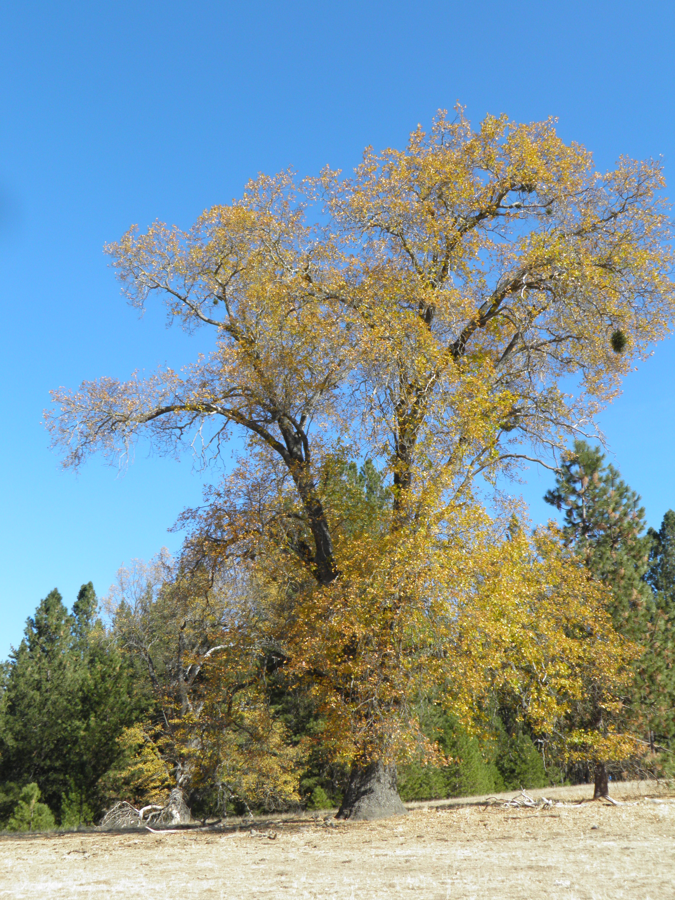
Thank you for joining us!
z
Logistics for next meeting (January 23, 2019)
Adjourn to Execute Session

